Slide 1
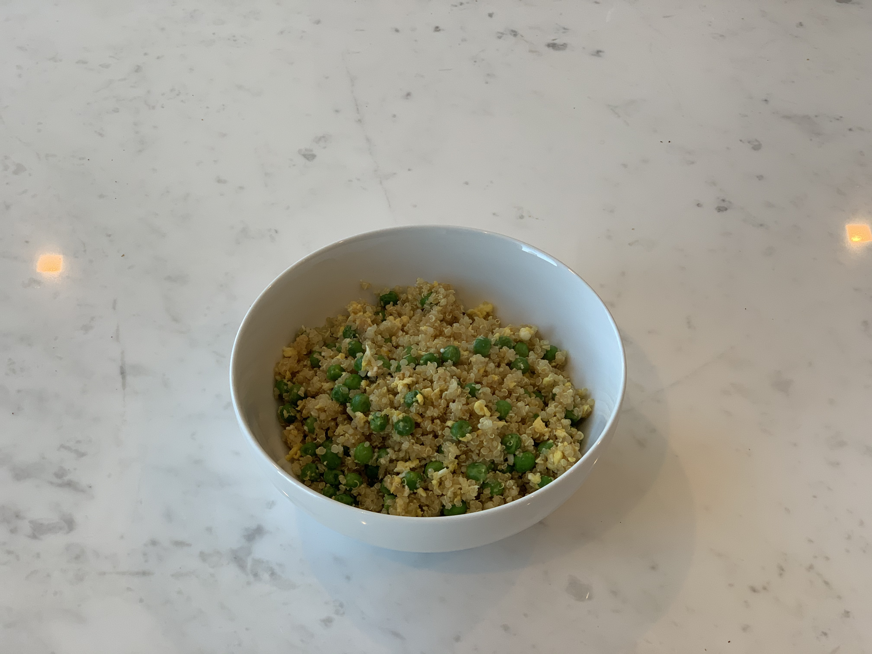
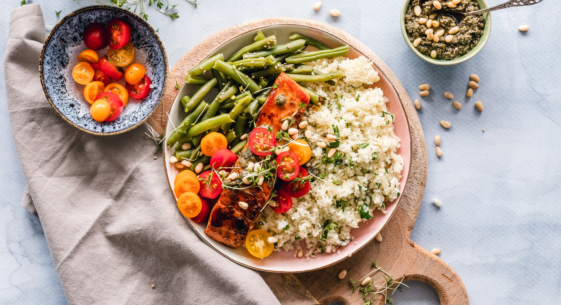


Quinoa* Fried Rice
Ingredients:
2 cups of quinoa 1 tsp oil
1 cup frozen peas 2 eggs
¼ cup chopped scallion (optional) 2 TBSP soy sauce
Cost: Ease:
Health Benefit: This meal is high in protein and fiber to help keep you and your family full longer!
Directions:
Cook quinoa or other grain according to package instructions; put aside in a bowl
Place oil in a pan over medium heat and place peas in pan until thawed
(about 1-2 minutes)
Add in eggs and scramble together with the peas
Mix peas and egg mixture into the quinoa; Mix in soy sauce
Top with scallions
Enjoy!
This is a very quick and easy dish that uses many staple household food items likely found in your pantry already. It can also feed a big crowd! It is great on its own or also great as an add into a salad. It also stays very well in the refrigerator – which makes it a great prepare-ahead option as well ;)
Substitutions:
It is not necessary to use quinoa for this recipe at all. You can also ubstitute with any family favorite grain, or whatever you have in your pantry.
Frozen peas can also be substituted with any other frozen or fresh vegetable, and can even be included with other vegetables of your choice! This would also be great with corn, cut up string beans, carrots or anything else on hand.
Cookware needed:
Large pot
Medium Pan
Spatula

